Slide 1


to
class

Slide 2







A. Gaffar Mozumder
Senior Teacher (English)
Uttarkhan Govt. Secondary School
Uttara, Dhaka.
01734101510
abdulgaffarmozumder@gmail.com
Gaffar Mozumder

Slide 3

# Class: Six # Sub: English 2nd
# Section: Golap # Time: 40 minutes
# Toatal SS: 60 # Date: 15. 02. 2018

Slide 4

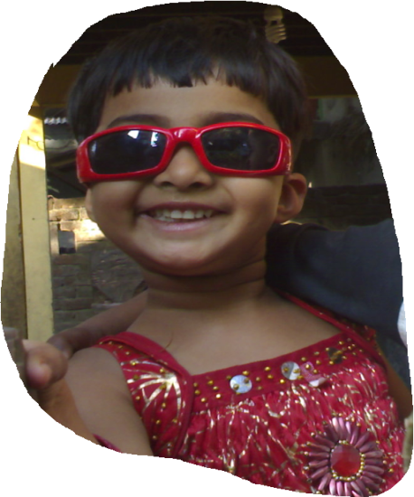
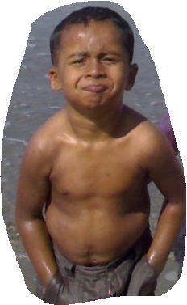
Look
The girl is laughing.
Isn’t the girl laughing ?
The boy looks strong.
Doesn’t the boy look strong?

Slide 5
Today’s topic
Changing Sentences
(Assertive—Interrogative)
Day: 1
Out of 2

Slide 6
Learning Outcomes:
By the end of this lesson
you will be able to
*express the idea about different types of sentences.
* change an assertive sentence into interrogative.
* use some auxiliary verbs.

Slide 7
Let's discuss
Rules & Examples

Slide 8
Rule: 1
Assertive:
S + auxiliary + V/extn.
Interrogative:
Auxiliaryn’t + S + V/extn?

Slide 9
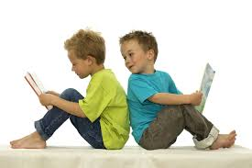
Examples:
We are students.
n’t
are
.
We students
?
Aren’t we students ?

Slide 10
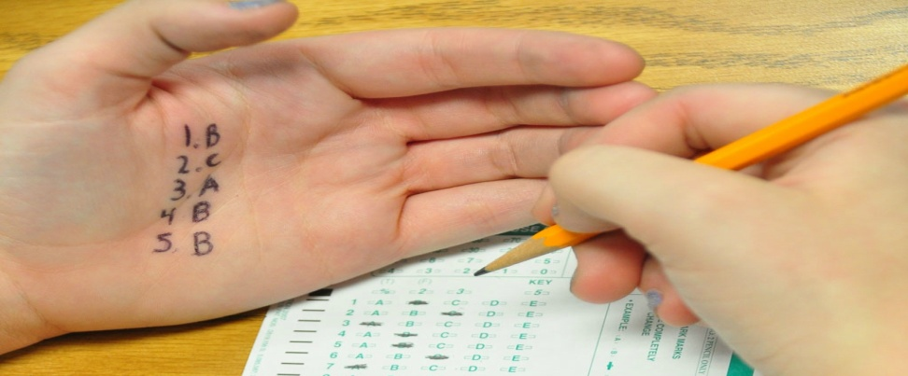
More Examples:
You should not cheat.
You not cheat
should
?
.
Should you cheat?

Slide 11
Some Auxiliary Verbs
am, is, are, was, were,
has, have, had,
shall, will, should, would,
can, could, may, might, must.

Slide 12

ATTENTION!!

Slide 13
is = Isn't
etc.
are = Aren't
have = Haven't
BUT
amn't
am = Aren't / Ain't
shall = Shan't
shalln't
will = Won't
willn't
can = Can't
cann't

Slide 14

Answers
Questions
Evaluation

Slide 15
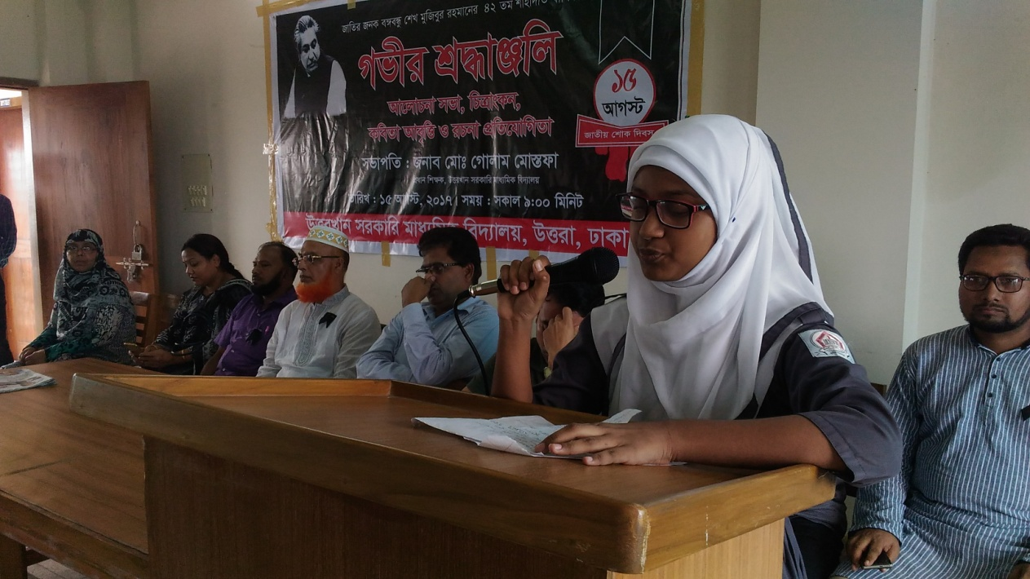
Do interrogative:
a) She is reciting a poem.

Slide 16
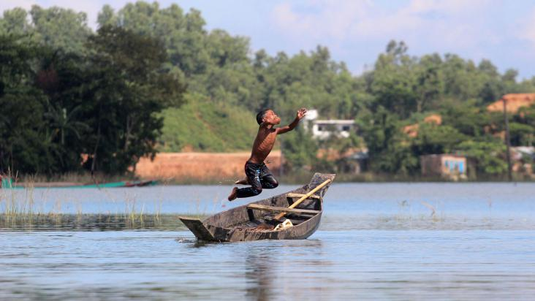
b) You should not be afraid.

Slide 17

c) We shall grow flowers.

Slide 18



Slide 19
Change into interrogative.
a) You will learn your lesson.
b) Bangladesh is a beautiful country.
c) These boys are not naughty.
d) I am busy now.
e) We should not tell a lie.

Slide 20



Slide 21
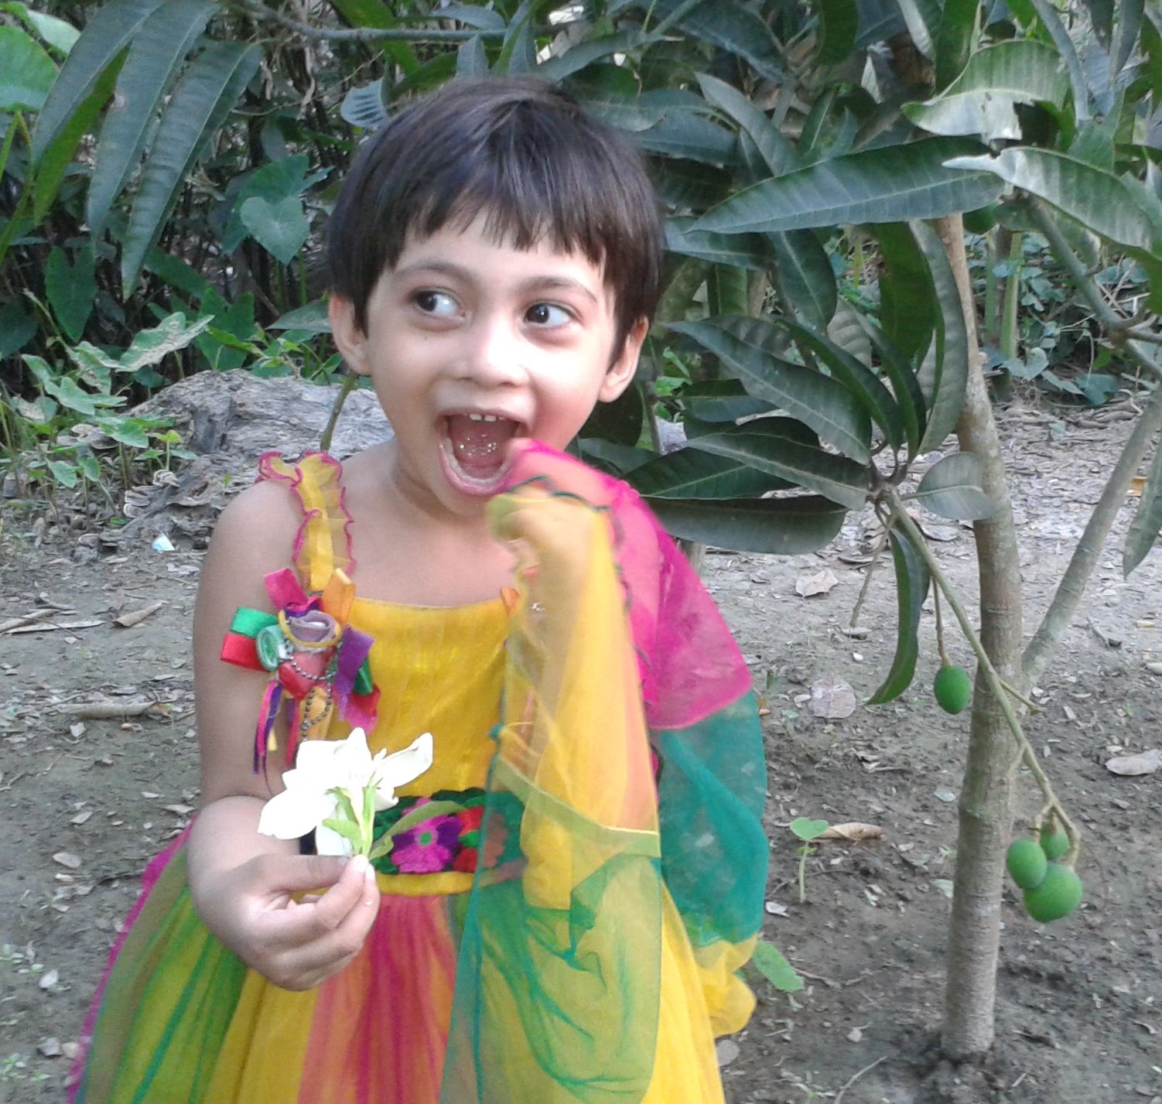
Thank You.

